Slide 1

Numerical Simulation of Quantum Size Effects
Ning Siyuan
10/11/2022

Slide 2
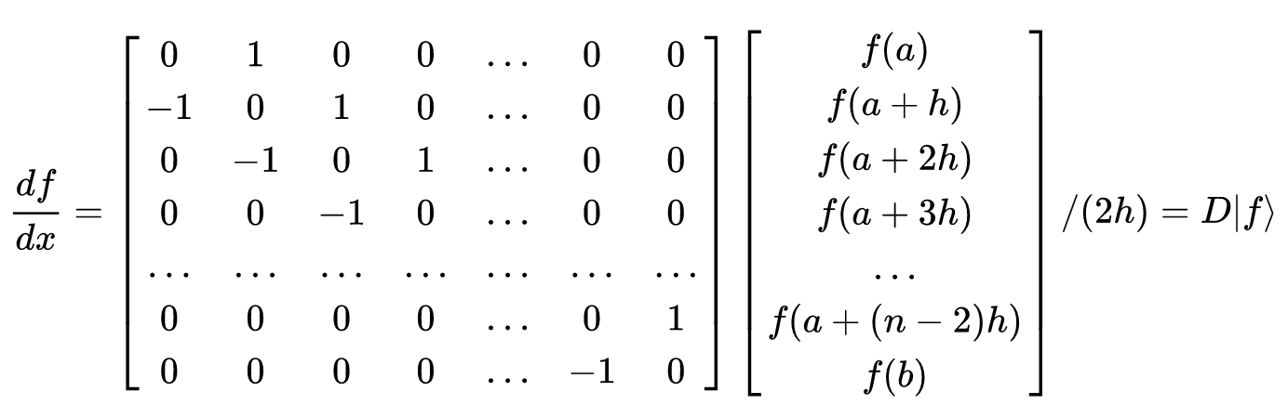
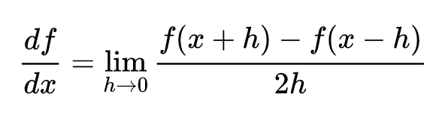
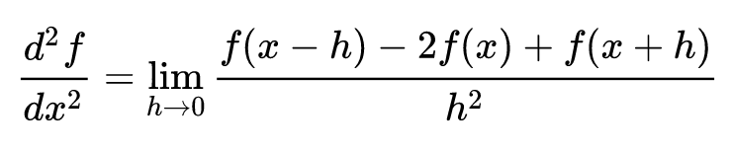
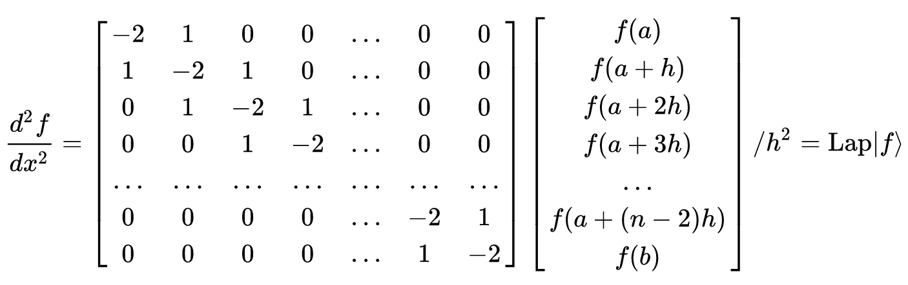
Methods
The Finite Difference Method

Slide 3
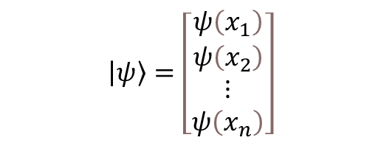

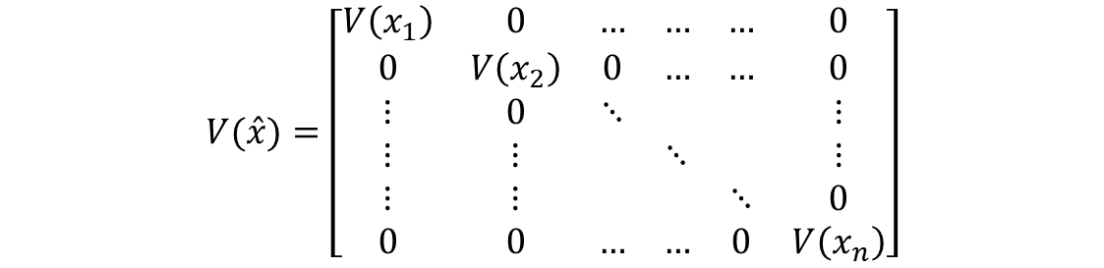
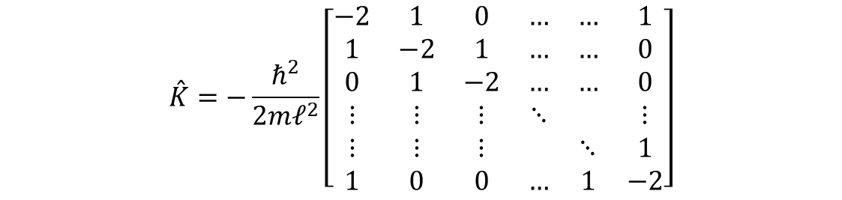

Methods
Differential Equation → Matrix Equation Express the Hamiltonian as a matrix operator
$$\left[−\frac{ℏ^{2}}{2m}\frac{d^{2}}{dx^{2}}+V\left(x\right)\right]\left|ψ\right\rangle =E\left|ψ\right\rangle$$
$$[\overset{ˆ}{K}+\overset{ˆ}{V}]|ψ⟩=E|ψ⟩$$
$$\overset{ˆ}{H}|ψ⟩=E|ψ⟩$$
$$\left|ψ\right\rangle =\left[\begin{matrix}ψ\left(x_{1}\right) \\ ψ\left(x_{2}\right) \\ ⋮ \\ ψ\left(x_{n}\right)\end{matrix}\right]$$
$$\overset{ˆ}{K}=−\frac{ℏ^{2}}{2m𝓁^{2}}\left[\begin{matrix}−2 & 1 & 0 & … & … & 1 \\ 1 & −2 & 1 & … & … & 0 \\ 0 & 1 & −2 & … & … & 0 \\ ⋮ & ⋮ & ⋮ & ⋱ & & ⋮ \\ ⋮ & ⋮ & ⋮ & & ⋱ & 1 \\ 1 & 0 & 0 & … & 1 & −2\end{matrix}\right]$$
$$V(\overset{ˆ}{x})=\left[\begin{matrix}V\left(x_{1}\right) & 0 & … & … & … & 0 \\ 0 & V\left(x_{2}\right) & 0 & … & … & 0 \\ ⋮ & 0 & ⋱ & & & ⋮ \\ ⋮ & ⋮ & & ⋱ & & ⋮ \\ ⋮ & ⋮ & & & ⋱ & 0 \\ 0 & 0 & … & … & 0 & V\left(x_{n}\right)\end{matrix}\right]$$

Slide 4
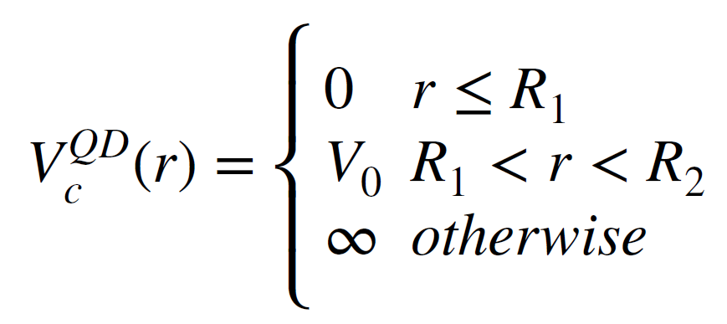
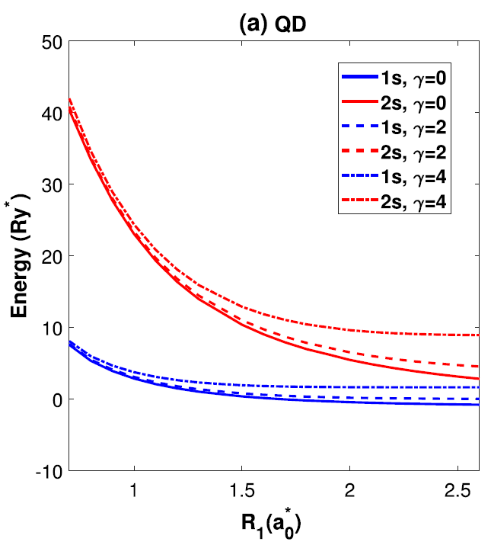
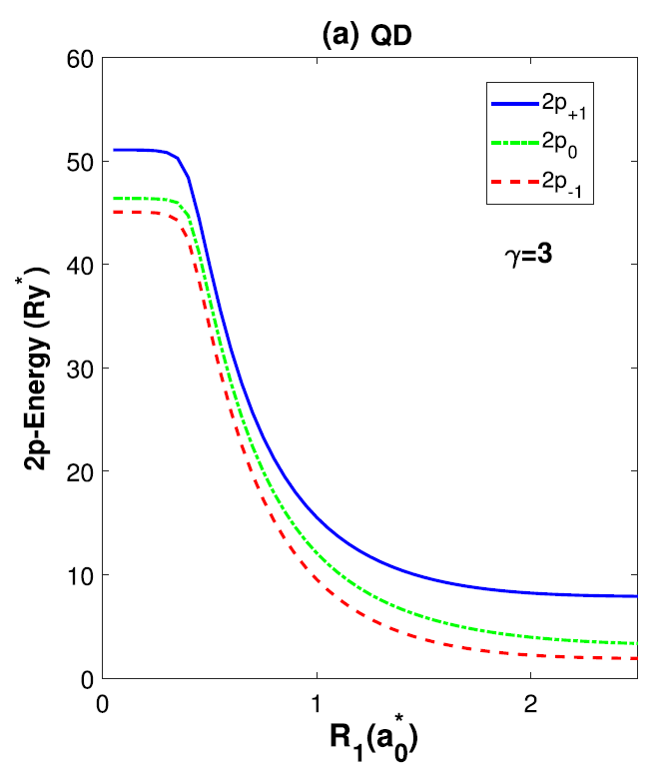
Results
① GaAs/Ga_{1-x}Al_{x}As core/shell quantum dots
Rahimi, F. et al. Opt Quant Electron 53, 47 (2021).

Slide 5
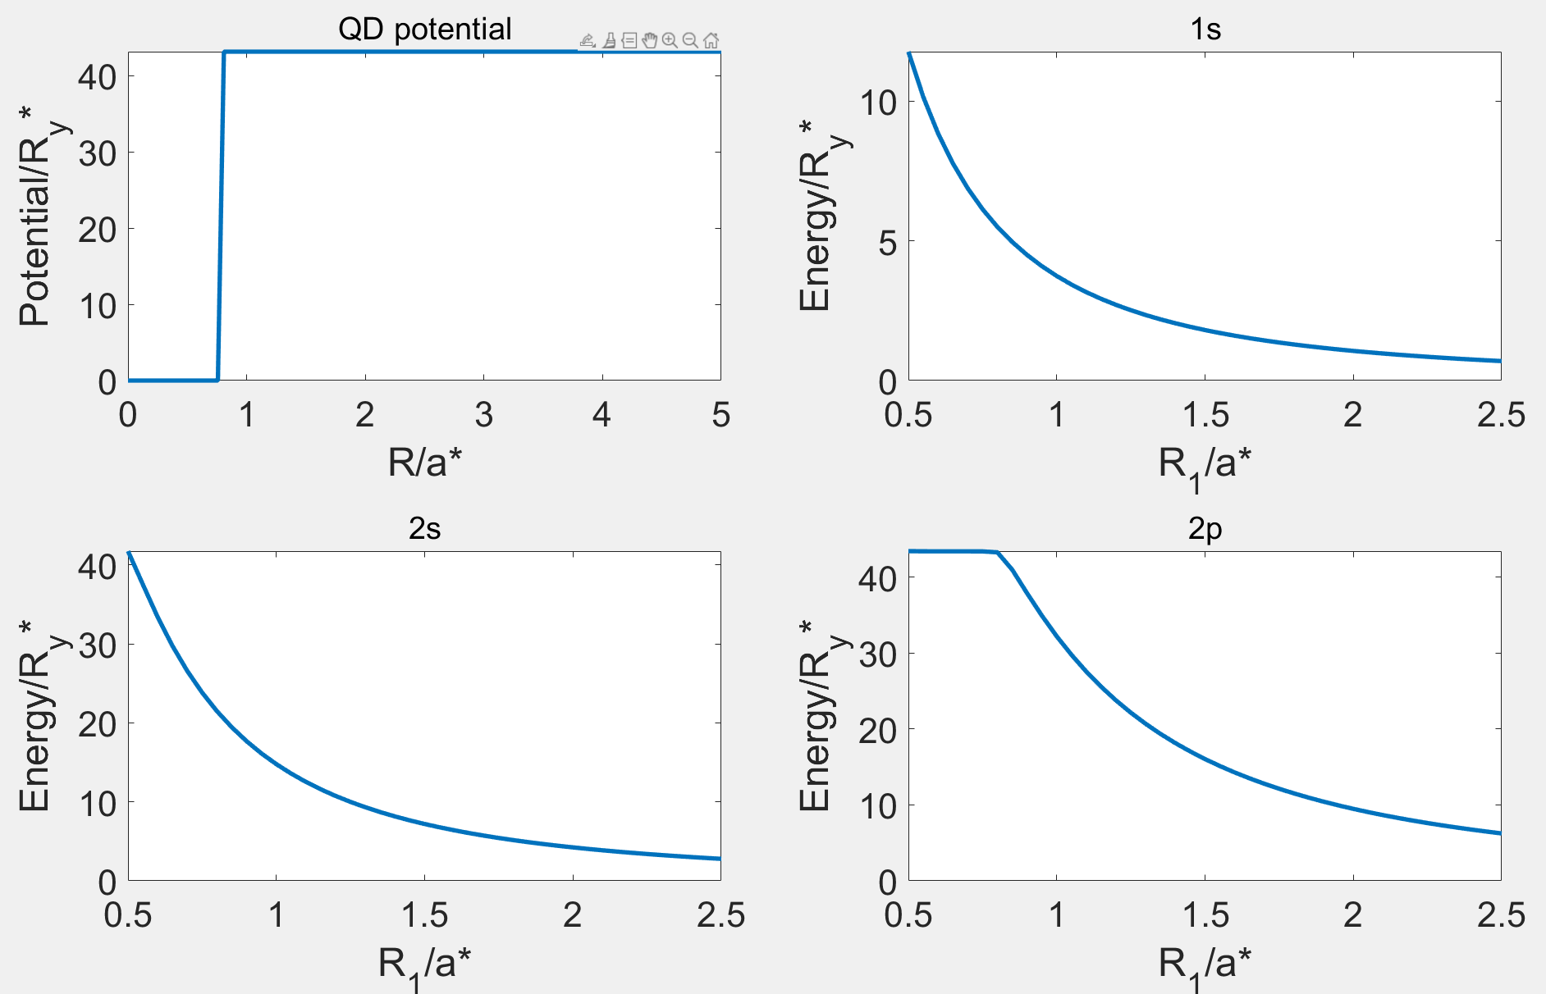
Results

Slide 6
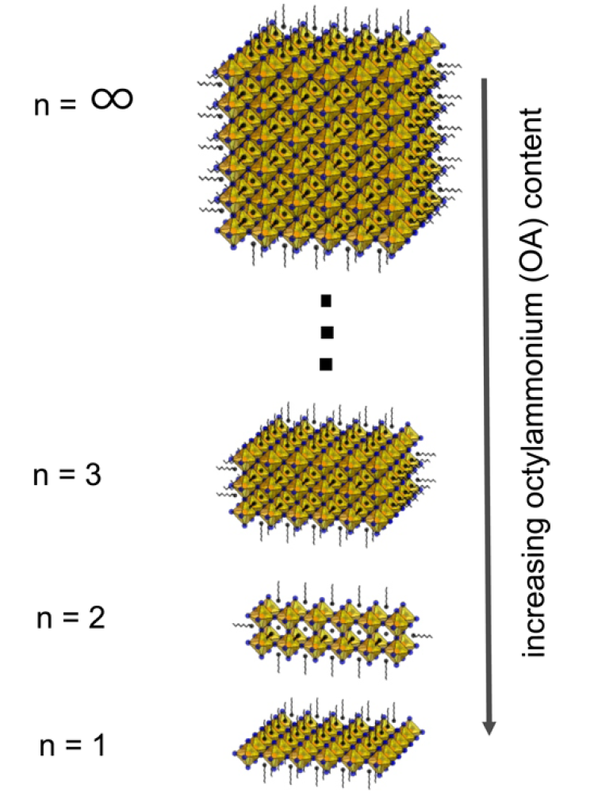
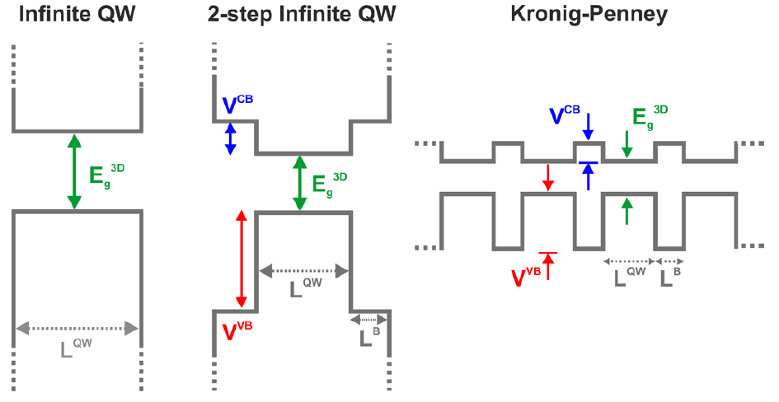
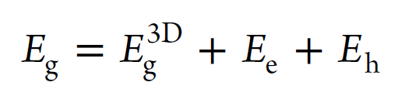
Results
② Methylammonium lead bromide (MAPbBr₃) Nanoplatelets
n_{e}=0
E_{g}
n_{h}=0

Slide 7
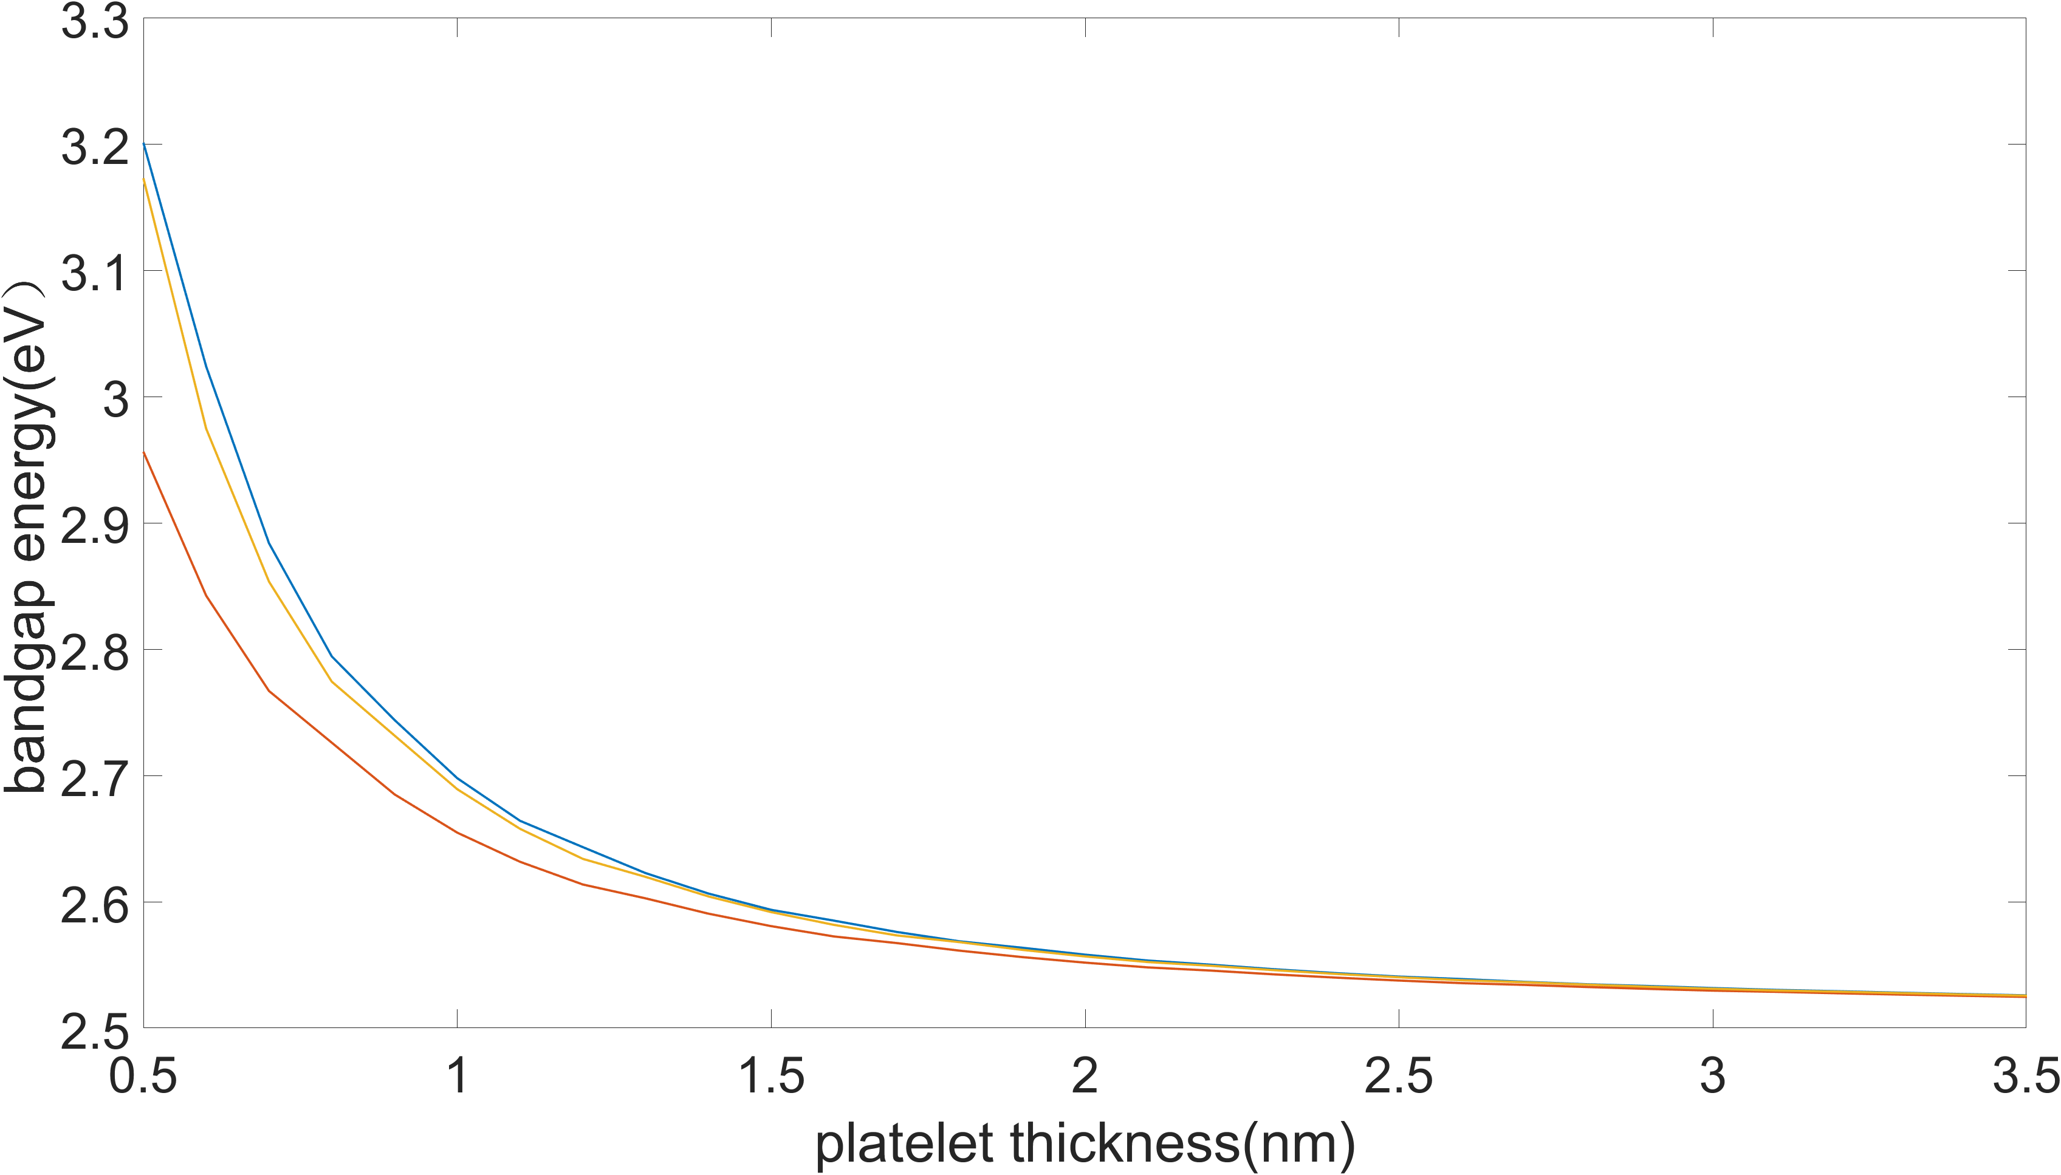
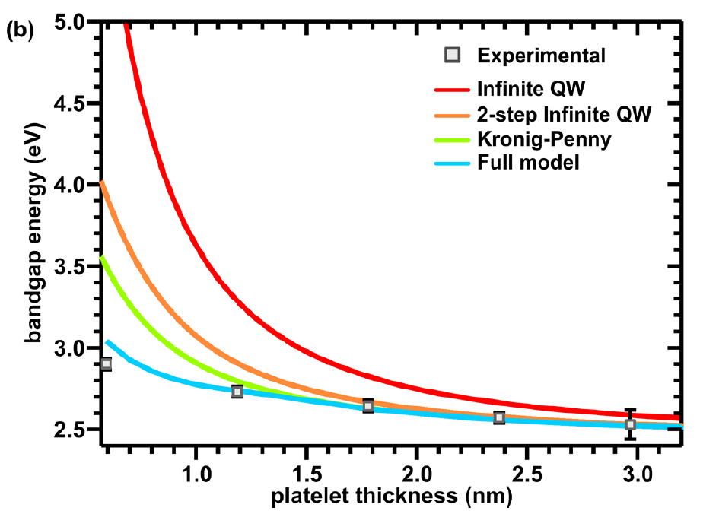
Results
Sichert, J. A. et al. (2015) Nano Letters, 15(10), 6521–6527.
Notes:
Sichert, J. A. et al. (2015) Nano Letters, 15(10), 6521–6527.

